Slide 1


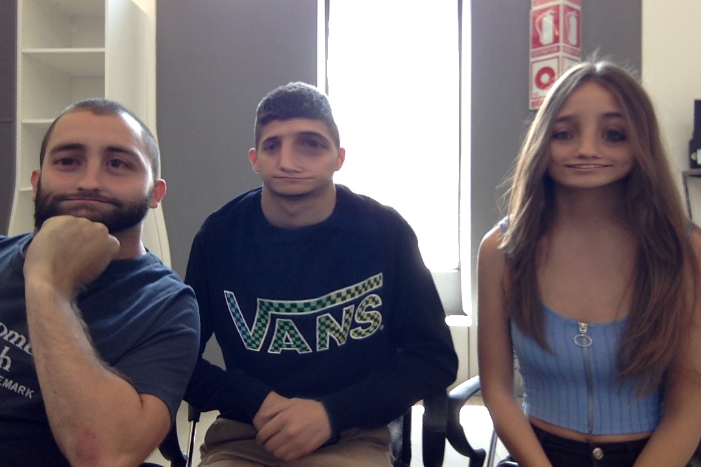


<TEAM NAME>
TEAM PICTURE
Mario Sanz
Maurizio Martin
Jennyfer Gonzalez
Brand Fan
Machine Learning
JSON
API
TECHNOLOGIES
Big Data
SQL
VR/AR
Php
NFC
Android

